Slide 1

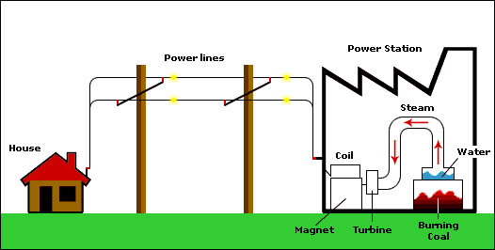
Chapter 2: Elements of Power Systems
Name of Topics | Duration (Hrs) | Assignment | %age of Coverage in Exams
Safety Devices and System | 2 | 5.5 | 5 to 10
The 3 Stages are:
Generation
Transmission
Distribution
Kashika Baranwal KEE-201 (Basic Electrical Engineering) Unit No.5

Slide 2
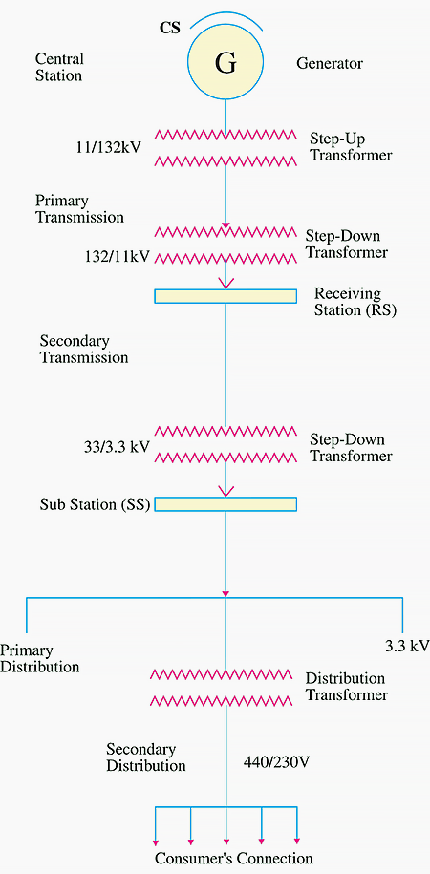
General Layout of Power System
The 3 Stages are:
Generation
Transmission
Distribution

Slide 3
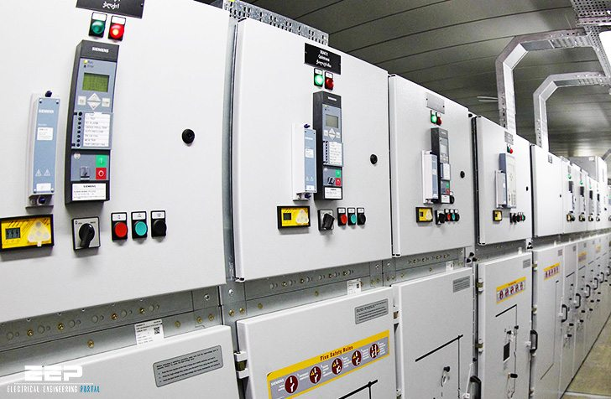
Safety Devices & Systems
Protection devices protect you and your equipment from electrical damage
Most electrical equipment has built in protection that will sense an increase in current
The protection device immediately shuts down the circuit
Kashika Baranwal KEE-201 (Basic Electrical Engineering) Unit No.5

Slide 4
Switchgear
The apparatus used for controlling, regulating and switching on or off the electrical circuit in the electrical power system are known as Switchgear Devices.
The switches, fuses, circuit breaker, isolator, relays, current and potential transformer, indicating instrument, lightning arresters and control panels are examples of the switchgear devices
Switchgears are used in Generation, Transmission and Distribution Systems.
Kashika Baranwal KEE-201 (Basic Electrical Engineering) Unit No.5

Slide 5
Types of Safety Devices
Switch
Fuse
Relay
Circuit Breaker
Switch Fuse Unit (SFU)
Kashika Baranwal KEE-201 (Basic Electrical Engineering) Unit No.5

Slide 6
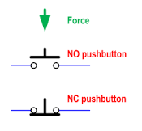
1. Switches
A switch is a device which is used to open or close an electric circuit in a convenient way.
It is a controlling device but it can not interrupt the fault currents
Kashika Baranwal KEE-201 (Basic Electrical Engineering) Unit No.5

Slide 7
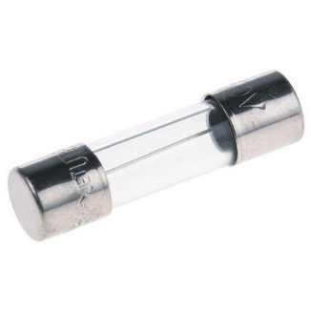

2. Fuse
Simplest and least expensive circuit protection device available
A fuse is a piece of wire with low melting point that acts as a sacrificial device to provide over current protection
If the current in a protected circuit becomes excessive, the metal part inside of the fuse heats up and melts, opening the electrical circuit the fuse is protecting
Kashika Baranwal KEE-201 (Basic Electrical Engineering) Unit No.5

Slide 8
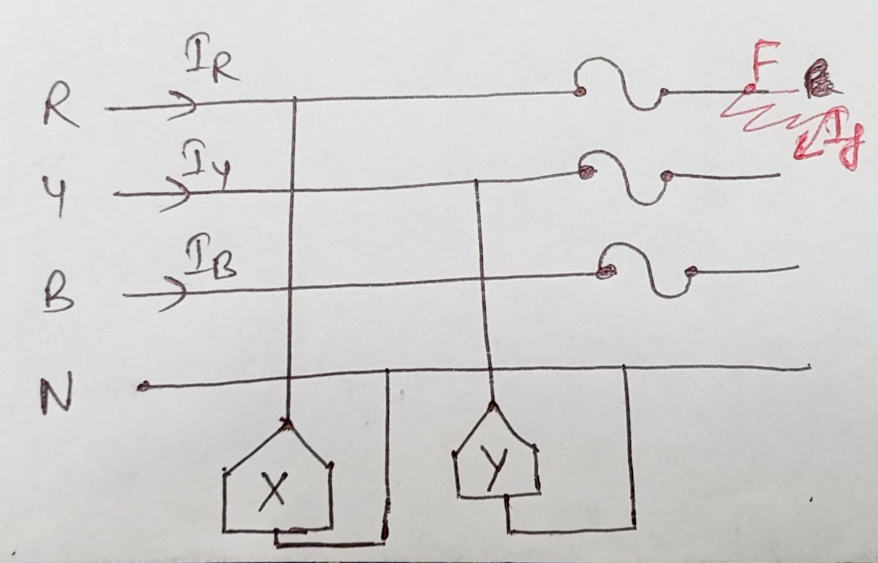
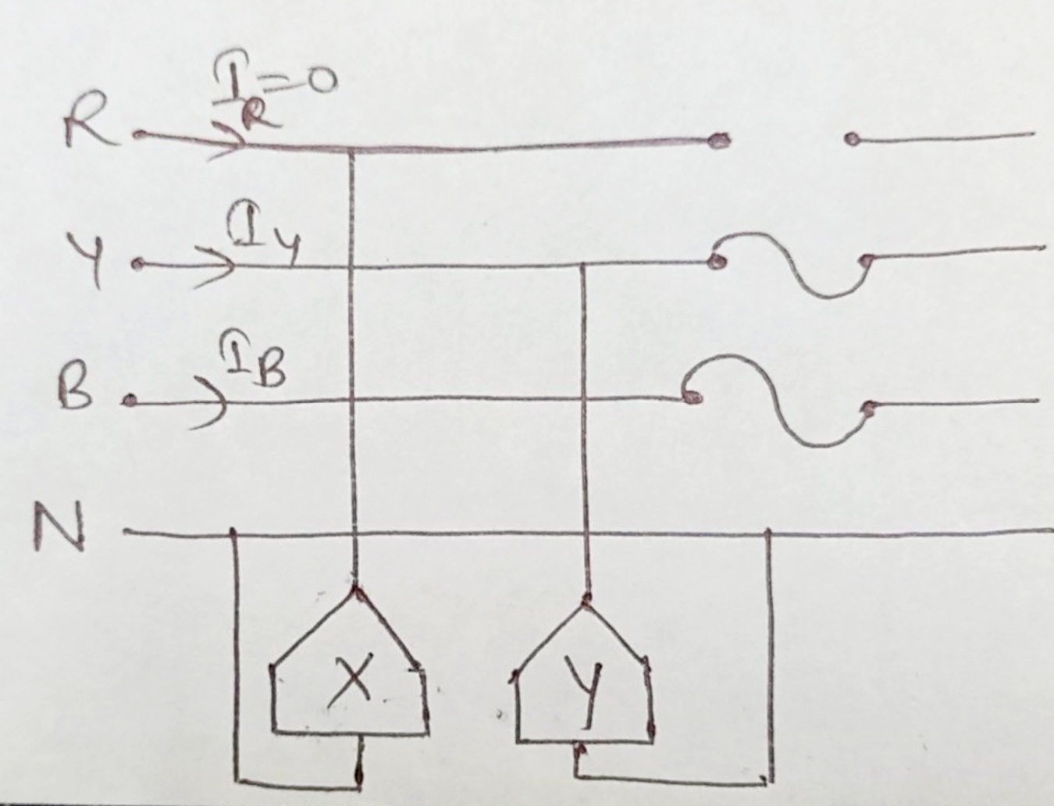

Slide 9
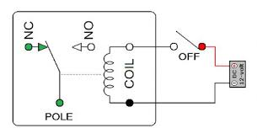
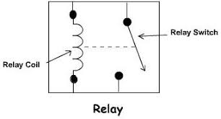
3. Relay
A protective relay is a compact device designed to sense the abnormal condition and trip a circuit breaker when a fault is detected
Kashika Baranwal KEE-201 (Basic Electrical Engineering) Unit No.5

Slide 10
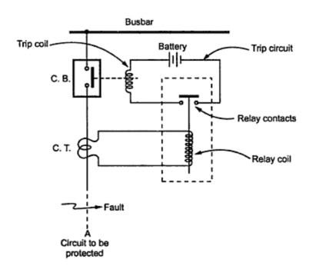
Switch Fuse Unit (SFU)
It has one switch unit and one fuse unit.
When we operate the breaker, the contacts will get closed through switch and then the supply will pass through the fuse unit to the output.
Whereas in a Fuse Switch Unit there is no separate switch and fuse unit.
SFU has been used to trip the circuit, particularly for high capacity tripping.
Switch fuse unit is a basic start and stop switch with a fuse of proper rating , now a days, hrc(high rupturing capacity) fuses are in use for industrial purposes

Slide 11
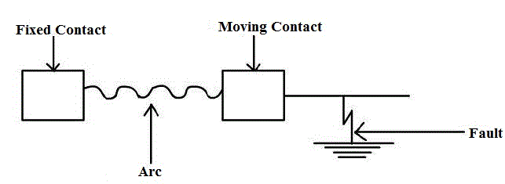
4. Circuit Breaker
The function of circuit breaker is same as a fuse but they are indestructible fuses
Circuit Breaker opens or trip a circuit when they sense an overload condition
A circuit breaker is a mechanical switching device, capable of making, carrying and breaking currents under normal circuit conditions
Circuit Breaker is used to isolate or separate the faulty section from the healthy section
A circuit breaker is an automatically operated electrical switch designed to protect an electrical circuit from damage caused by overcurrent/overload or short circuit. Its basic function is to interrupt current flow after protective relays detect fault conditions
Kashika Baranwal KEE-201 (Basic Electrical Engineering) Unit No.5

Slide 12
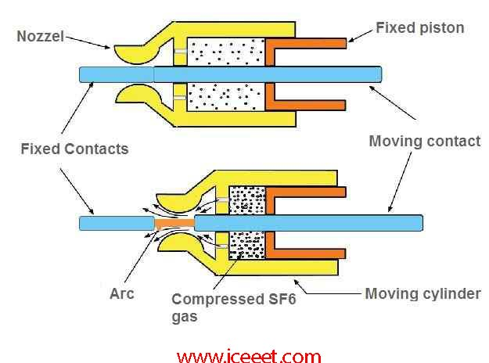
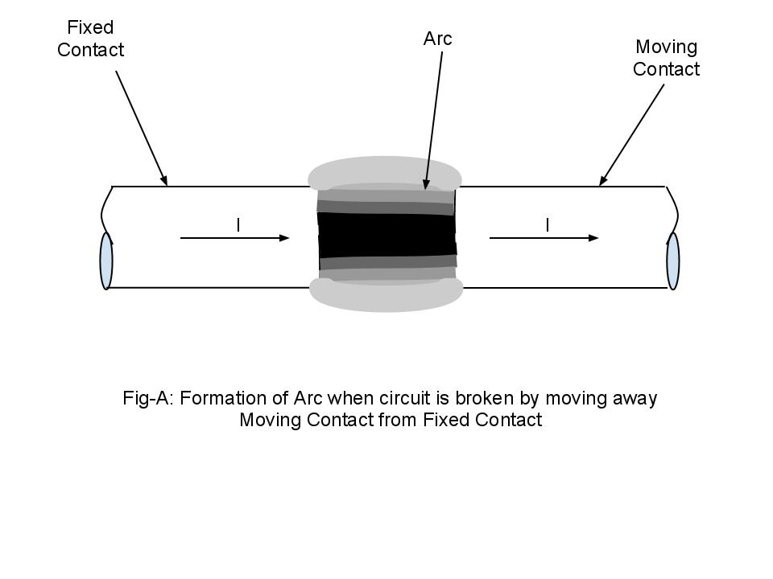
Circuit Breaker
Kashika Baranwal KEE-201 (Basic Electrical Engineering) Unit No.5

Slide 13
Circuit Breaker
Circuit Breaker consists of two contacts: Fixed contact & Moving contact
Moving contact is used to make and break the circuit using stored energies in the form of spring or compressed air.
Spring, Pneumatic or oil damping is used to arrest the speed of MC while closing
FC contains a spring which holds the MC after closing
CBs are usually arranged with pilot devices to sense a fault current and to operate the trip opening mechanism
Kashika Baranwal KEE-201 (Basic Electrical Engineering) Unit No.5

Slide 14
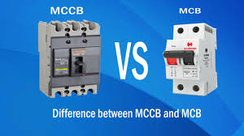
Miniature Circuit Breaker (MCB)
It is used for protecting the circuit against overload and short circuit
It can be used in lighting and electric motor distribution systems
An MCB is a better alternative to a fuse since it does not require replacement once an overload is detected
Unlike fuse, an MCB can be easily reset and thus offers improved operational safety and greater convenience without incurring large operating cost
Kashika Baranwal KEE-201 (Basic Electrical Engineering) Unit No.5

Slide 15
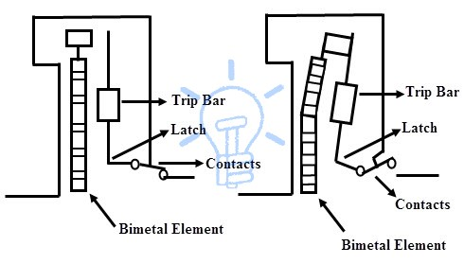
Miniature Circuit Breaker (MCB)
If the circuit is overloaded for a long time, the bi-metallic strip becomes overheated and deformed. This deformation of Bi-metallic strip causes, displacement of latch point. The moving contact of the MCB is arranged by means of spring pressure, with this latch point, that a little displacement of latch causes, release of spring and makes the moving contact to move for opening the MCB.
When the moving contact separated from fixed contact, there may be a high chance of arc. This arc then goes up through the arc runner and enters arc splitters and is finally quenched. When we switch it on, we reset the displaced operating latch to its previous on position and the MCB is ready for another switch off or trip operation.
Kashika Baranwal KEE-201 (Basic Electrical Engineering) Unit No.5

Slide 16
MCB Vs MCCB
MCCB stands for molded case circuit breaker.
It is used to control electric energy in distribution network and is having overload and short circuit protection.
The main difference between the two is their capacity where MCCB is rated for currents much higher than that of MCB
The current interruption rating for an MCCB is much higher and up to 2500 A.
MCBs are mostly installed for home use, while an MCCB is generally utilized for commercial or industrial purposes.
Kashika Baranwal KEE-201 (Basic Electrical Engineering) Unit No.5

Slide 17
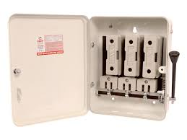
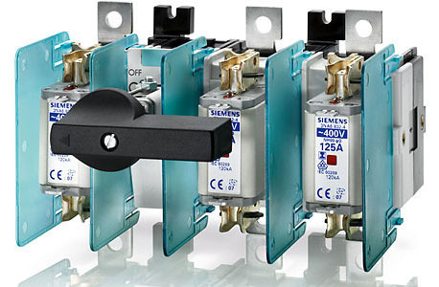
How SFU Looks Practically !!
Kashika Baranwal KEE-201 (Basic Electrical Engineering) Unit No.5

Slide 18

Daily Quiz
SFU stands for ………?
…….. is defined as the product of electrical power and time of operation.
The cost of Fuse is ……. than that of circuit breaker.
MCCB has ………. current interrupting capacity as compared to MCB.
Kashika Baranwal KEE-201 (Basic Electrical Engineering) Unit No.5

Slide 19
Weekly Assignment
One line Answer type Questions:
Q.1) What is the application of Fuse?
Short Answer type Questions:
Q.2) Explain SFU, MCB.
Q.3) Explain ELCB, MCCB.
Kashika Baranwal KEE-201 (Basic Electrical Engineering) Unit No.5

Slide 20
Multiple Choice Question
Q.1) Which of the following is not a switching device: Switches Isolators Fuse Circuit Breaker | Q.4) Which of the following is not a fault: Short Circuit Over Loading Insulation Failure Tripping of Circuit
Q.2) Which of the following is cheapest protection element used in electrical systems- Isolator Fuse Relay Circuit Breaker | Q.5) Which of the following medium is not employed for extinction of arc in circuit breakers- Water Oil Air SF₆ Gas
Q.3) A fuse has- High Resistivity and Low Melting Point Low Resistivity and High Melting Point High Resistivity and High Melting Point Low Resistivity and Low Melting Point
Kashika Baranwal KEE-201 (Basic Electrical Engineering) Unit No.5

Slide 21

Questions from Previous Papers
Q.1) Explain SFU, MCB. [AKTU: 2018-19]
Q.2) Explain ELCB, MCCB. [AKTU: 2018-19]
Q.3) Write full form of- SFU, MCB, MCCB and ELCB. [AKTU: 2019-20]
Kashika Baranwal KEE-201 (Basic Electrical Engineering) Unit No.5

Slide 22
Expected Questions for University Exam
Q.1) Explain SFU, MCB, ELCB, MCCB.
Q.2) Differentiate between MCB and MCCB.
Q.3) Justify the statement- “Relay is called brain of the circuit breaker”.
Kashika Baranwal KEE-201 (Basic Electrical Engineering) Unit No.5

Slide 23
Necessity of Earthing
(Electricity can be dangerous)
1) Overloading: Adapters are used to connect more than one appliance to a main socket. This may draw large current which makes the wire to get hot. When the current is too large, the circuit is said to be overloaded
2) Short circuits: Broken or bare wire in a circuit may touch another wire in the circuit causes a short circuit. This may cause fire in the wires or in the appliance
3) Wet Conditions: If a person touches a damaged electrical wire or appliance with wet hands, an electric current may flow through his body – electric shock
Kashika Baranwal KEE-201 (Basic Electrical Engineering) Unit No.5

Slide 24
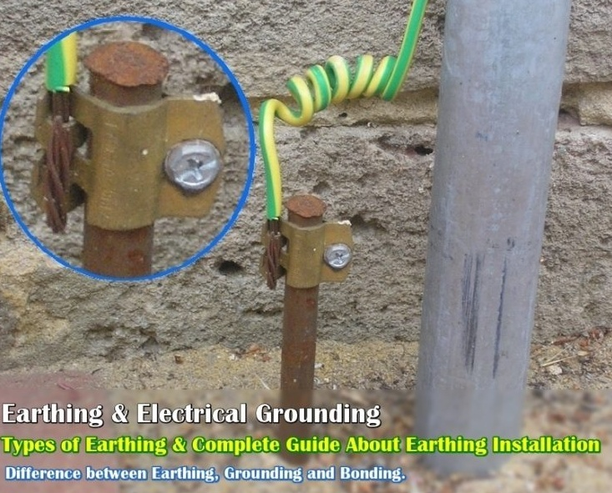
What is Earthing??
The metallic parts of electric machinery and devices to the earth plate or earth electrode through a thick conductor wire (which has very low Resistance) for safety purpose is known as Earthing or grounding.
Kashika Baranwal KEE-201 (Basic Electrical Engineering) Unit No.5

Slide 25
Measurements and Sensors (CO5)
Name of Topics | Duration (Hrs) | Assignment | %age of Coverage in Exams
Necessity of Earthing, Types of earthing | 2 | 5.4 | 5 to 10
Kashika Baranwal KEE-201 (Basic Electrical Engineering) Unit No.5

Slide 26
Earthing and its Importance
The process of transferring the immediate discharge of the electrical energy directly to the earth by the help of the low resistance wire is known as the electrical earthing
Provide an alternative path for the fault current to flow so that it will not endanger the user or other electrical systems.
Earthing ensures that all exposed conductive parts do not reach a dangerous potential
Kashika Baranwal KEE-201 (Basic Electrical Engineering) Unit No.5

Slide 27
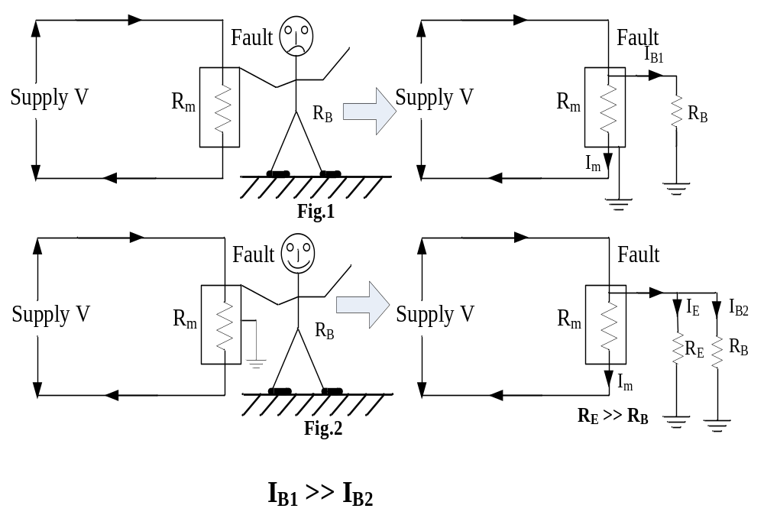
Earthing

Slide 28
Daily Quiz
Earthing provides a ……. resistive path for the fault current to flow.
Electrical system is grounded in order to protect ……. from faults.
Kashika Baranwal KEE-201 (Basic Electrical Engineering) Unit No.5

Slide 29
Weekly Assignment
One line Answer type Questions:
Q.1) Why earth pin is made thicker and bigger than line and neutral?
Short Answer type Questions:
Q.2) Explain the need of Earthing.
Long Answer type Questions:
Q.3) What is the importance of Earthing ? Explain one method of earthing.
Kashika Baranwal KEE-201 (Basic Electrical Engineering) Unit No.5

Slide 30
Multiple Choice Questions
Q.1) Which of the following is not a method of earthing- Plate Earthing Pipe Earthing Earthing through Air Medium Rod Earthing | Q.3) Purpose of earthing is to protect from- Voltage Fluctuation Danger of electric shock Overloading High Temperature of condutors
Q.2) Earthing wire is a high resistance path: True False | Q.4) Grounding is same as Earthing: True False
Kashika Baranwal KEE-201 (Basic Electrical Engineering) Unit No.5

Slide 31

Questions from Previous Papers
Q.1) Why earth pin is made thicker and bigger than line and neutral?[AKTU: 2018-19]
Q.2) What is the importance of Earthing? Explain one type of earthing.[AKTU: 2018-19]
Q.3) Define the purpose of Earthing the electrical appliances. [AKTU: 2018-19]
Q.4) Why earth pin is made thicker and bigger than line and neutral?[AKTU: 2018-19]
Kashika Baranwal KEE-201 (Basic Electrical Engineering) Unit No.5

Slide 32
Expected Questions for University Exam
Q.1) Define the purpose of earthing the electrical appliances.
Q.2) Explain different methods of earthing.
Q.3) Why earth pin is made thicker and bigger than line and neutral?
Q.4) What is difference between neutral and earthing?
Kashika Baranwal KEE-201 (Basic Electrical Engineering) Unit No.5

Slide 33
Elementary Calculations for Energy Consumption (CO5)
Name of Topics | Duration (Hrs) | Assignment | %age of Coverage in Exams
Elementary Calculations for Energy Consumption | 2 | 5.4 | 5 to 10
Kashika Baranwal KEE-201 (Basic Electrical Engineering) Unit No.5

Slide 34
Elementary Calculations for Energy Consumption (CO5)
How do Power Companies know how much Electricity we Consume ??
Kashika Baranwal KEE-201 (Basic Electrical Engineering) Unit No.5

Slide 35
Elementary Calculations for Energy Consumption
Done with the help of Electricity meters/Energy meters
Unit for electricity meters = kilowatt-hour (kWh)
1 Unit = 1 kWh
Energy consumed (in kWh) = Power (in kW) x Time (in hours)
Cost of electrical energy = units of electrical energy used (kWh) x Cost per unit
Kashika Baranwal KEE-201 (Basic Electrical Engineering) Unit No.5

Slide 36
Elementary Calculations for Energy Consumption
Example:
An Electric Kettle has a power rating of 2400 Watts. It has been used to keep water warm for 2 hours. Calculate the cost of electricity used/month if each unit costs is 7 Rs.
Kashika Baranwal KEE-201 (Basic Electrical Engineering) Unit No.5

Slide 37
Elementary Calculations for Energy Consumption
Example:
A Geyser has a power rating of 3600 Watts. It has been used for 90 minutes. Calculate the cost of electricity used per day, if each unit costs is 10 Rs.
Kashika Baranwal KEE-201 (Basic Electrical Engineering) Unit No.5

Slide 38
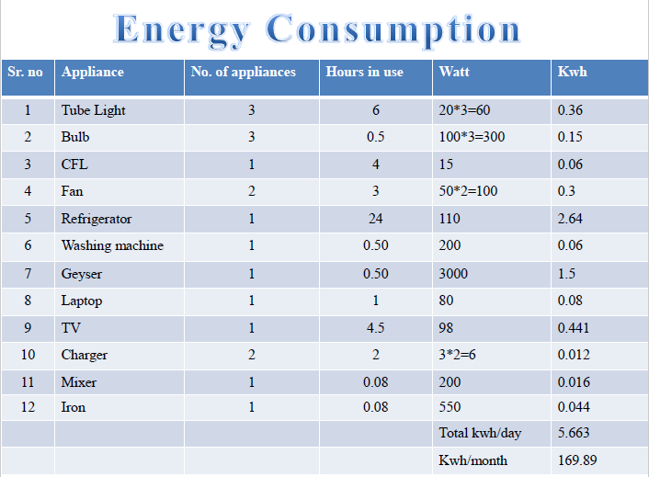
Example of Energy Consumption Calculation

Slide 39
Daily Quiz
1000 Watts is equal to …… kWh.
1 unit of electrical energy consumption is equivalent to ……. kWh.
Energy consumed by a Geaser of 2400 Watt, working for 100 minutes a day is ………. kWh?
Energy consumed by 2 CFLs of 40 Watt each, working 6 hours a day is ………. kWh?
Kashika Baranwal KEE-201 (Basic Electrical Engineering) Unit No.5

Slide 40
Weekly Assignment
Short Answer type Questions:
Q.1) Calculate the energy consumption per day in a house using 5 CFL of 20W each, 3 fans of 60W each, for 3 hrs a day.
Q.2) What is the method for the calculation of energy consumption?
Kashika Baranwal KEE-201 (Basic Electrical Engineering) Unit No.5

Slide 41
Multiple Choice Questions
Q.1) An oven with a power rating of 3600 Watt is used to bake a cake for 1 hour. What is its energy consumption- 0.36 kWh 3.6 kWh 360 kWh 3600 kWh | Q.3) What is the energy usage of a 1000 watt hair dryer used for 10 minutes straight? 1000 watt x 10 minutes = 10 kWh 1000 watts/10 min = 100 kW/h 1000 watts x 10 minutes = 100,000 kWh None of the above
Q.2) What is the unit of electrical power- Joule Watt kWh None of the above | Q.4) One unit consumption is equivalent to- 10 kWh 1000 W-h 1000 kWh 10 W-h
Kashika Baranwal KEE-201 (Basic Electrical Engineering) Unit No.5

Slide 42

Questions from Previous Papers
Q.1) Calculate the energy consumption per day in a house using 5 CFL of 20W each, 3 fans of 60W each, for 3 hrs a day. [AKTU: 2018-19]
Kashika Baranwal KEE-201 (Basic Electrical Engineering) Unit No.5

Slide 43
Expected Questions for University Exam
Q.17) Calculate the Electricity bill of the house for the month of July with following load data of one day:
A Kettle of 2200 W is operated for 600 Seconds
A Washing Machine of 300 W is operated for 45 Minutes
A Toaster of 750 W is operated for 15 Minutes
Two Fluorescent light of 40 W each is operated for 5 Hours and 6 Hours respectively.
Three Fans of 60 W is operated for 4 Hours, 6 Hours and 12 hours respectively.
A Refrigerator of 250 W is operated for 24 Hours
(Use the cost per unit of electricity as 7 Rs in your calculations)
Q.18) Calculate the energy consumption in a system that consumes 190 Watts of power and works for 3 hrs a day.
Kashika Baranwal KEE-201 (Basic Electrical Engineering) Unit No.5

Slide 44
Battery Backup
Name of Topics | Duration (Hrs) | Assignment | %age of Coverage in Exams
Battery Backup | 2 | 5.4 | 5 to 10
Kashika Baranwal KEE-201 (Basic Electrical Engineering) Unit No.5

Slide 45
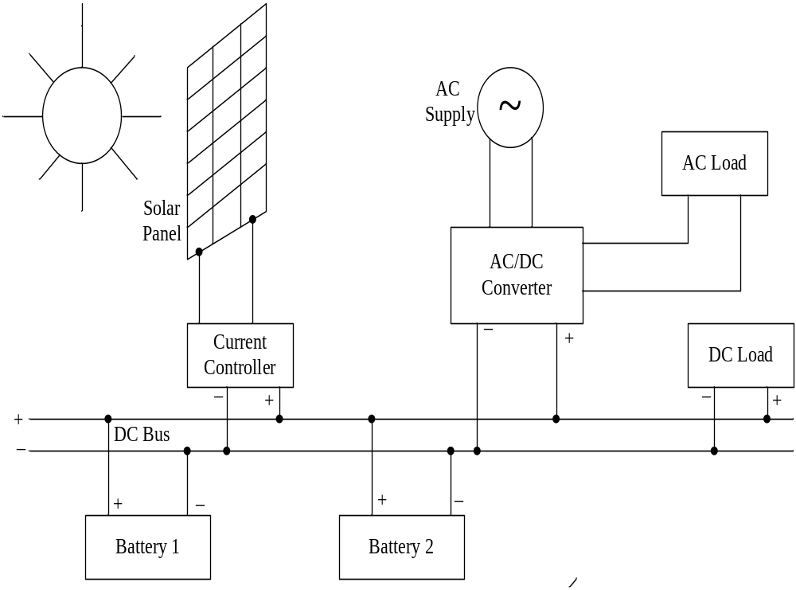
Battery Backup (CO5)
A battery backup provides power to a system when the primary source of power is unavailable.
Normal Mode: Charging of battery and load driven by main source of power
Backup Mode: Discharging of battery and load driven by battery.

Slide 47
Battery Backup (CO5)
Function of inverter:
(With battery backup)
When AC mains power supply is available (Charging of batteries)
When supply is available, the AC mains sensor activate end supply directly pass to the output socket, load will be driven by supply, at the same time 230V AC voltage is converted to 12 Volt DC, AC/DC converter acts as rectifier and DC voltage is used for charging of batteries.
When AC mains power supply is not available (Discharging of batteries)
When AC main supply is not available, AC/DC converter acts as inverter which convert DC voltage into 230V AC. In this case inverter takes power from batteries and this 230V AC is made available at output socket and hence load will be driven by battery backup.
In Addition to this, solar power is used for the charging of batteries.

Slide 48
Battery Backup
A Power failure in a hospital would result in life-threatening conditions for patients. Patients undergoing surgery or on life support are reliant on a consistent power supply. Backup generators or batteries supply power to critical equipment until main power can be restored.
For household application battery backup is required when primary source of power is unavailable.(Inverter)
Required at power stations and for computers.
Kashika Baranwal KEE-201 (Basic Electrical Engineering) Unit No.5

Slide 49
Daily Quiz
Battery is a series and parallel combination of ………?
Cells are connected in ……. to increase current capacity of battery.
Cells are connected in ……. to increase voltage rating of battery.
Chemical reactions are not reversible in ……… batteries.
Batteries used in Cars are ………. type of battery.
Kashika Baranwal KEE-201 (Basic Electrical Engineering) Unit No.5

Slide 50
Daily Quiz
An inverter converts …… supply to ……. supply.
A battery of 2 Amp-Hr rating can supply a load current of 0.5 A for ……. Hrs?
Li-ion battery is a type of ……….. Battery.
Watt-Hour efficiency is the product of Amp-Hour efficiency and …………… of the battery.
Kashika Baranwal KEE-201 (Basic Electrical Engineering) Unit No.5

Slide 51
Weekly Assignment
One word Answer type Questions:
Q.1) What is the principle of Battery?
Q.2) List the Characteristics of battery.
One line Answer type Questions:
Q.3) What is the difference between primary and secondary batteries?
Q.4) Explain the different types of battery.
Long Answer type Questions:
Q.3) Explain battery Backup.
Kashika Baranwal KEE-201 (Basic Electrical Engineering) Unit No.5

Slide 52
Multiple Choice Questions
Q.1) Number of cells connected in series provide a- High current carrying capacity Higher voltage Higher power None of the above | Q.3) Number of cells connected in parallel provide a- High current carrying capacity Higher voltage Higher power None of the above
Q.2) Purpose of Backup Protection is- To guard against failure of primary To increase the speed To leave no blind spot None of the above | Q.4) An inverter converts AC to DC DC to AC DC to AC and vice-versa AC to AC (with changed frequency
Kashika Baranwal KEE-201 (Basic Electrical Engineering) Unit No.5

Slide 53
Questions from Previous Papers
Q.1) Explain battery Backup in brief. [AKTU: 2018-19]
Q.2) Draw the characteristics of battery. Calculate the backup of battery of 100 A-H connected to a load of 100 Watts and supply voltage is 12 Volts. [AKTU: 2018-19]
Kashika Baranwal KEE-201 (Basic Electrical Engineering) Unit No.5

Slide 54
Questions from Previous Papers
Q.5) An alkaline cell is discharged at a steady current of 4 A for 12 hours, the average terminal voltage being 1.2 V. To restore it to original state of voltage, a steady current of 3 A for 20 hours is required, the average terminal voltage being 1.44 V. Calculate the ampere-hour and watt-hour efficiencies in this particular case. [AKTU: 2019-20]
Q.6) What are the factors that affect the battery capacity? [AKTU: 2019-20]
Kashika Baranwal KEE-201 (Basic Electrical Engineering) Unit No.5

Slide 55
Expected Questions for University Exam
Q.1) What are the factors that affect battery capacity?
Q.2) Describe battery-backup in brief.
Q.3) Draw the charging and discharging characteristics of lead acid battery.
Q.4) What are various types of batteries? Also write its applications.
Q.5) A battery takes a current of 5.2 A for 24 hours while charging, the terminal voltage being 2.25 V. While its discharging current is 4.5 A for 24 hours at an average terminal voltage of 1.85 v. Calculate its Ampere-Hour Efficiency.
Kashika Baranwal KEE-201 (Basic Electrical Engineering) Unit No.5

Slide 56

Recap
Concept of Batteries
Battery Backup
Kashika Baranwal KEE-201 (Basic Electrical Engineering) Unit No.5

Slide 57
Summary
General layout of Power System & its components
  SFU
  Relays, MCB, MCCB & ELCB
  Batteries
Wires and Cables & Earthing
  Types of wires & cables
  Concept of Earthing
  Types of Earthing
Energy Consumption
  Concept
  Numerical problems
Daily Quiz
Multiple Choice Questions/ Previous Year Questions
Assignments
Kashika Baranwal KEE-201 (Basic Electrical Engineering) Unit No.5

